Slide 1
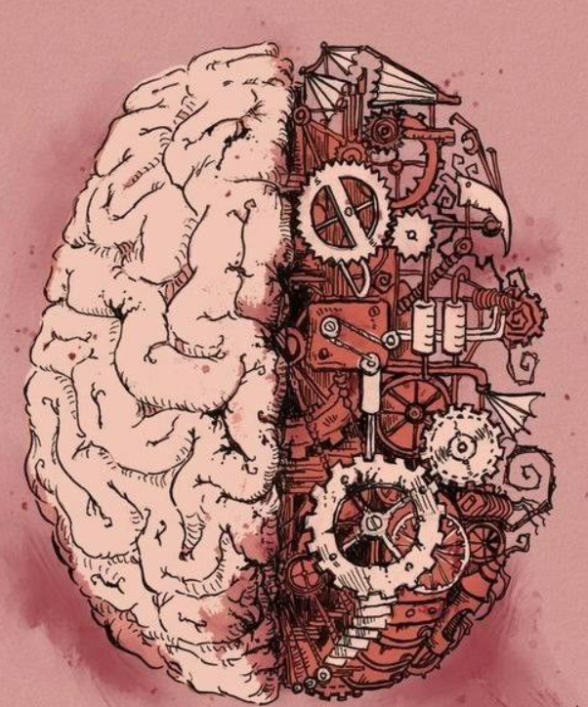
The anatomy of Human Brain
Presentation by:
Sibendra Timalsina
Sandip Shah
Reviewed by:
Deepak Rana Magar
Aananda Bhusal

Slide 2
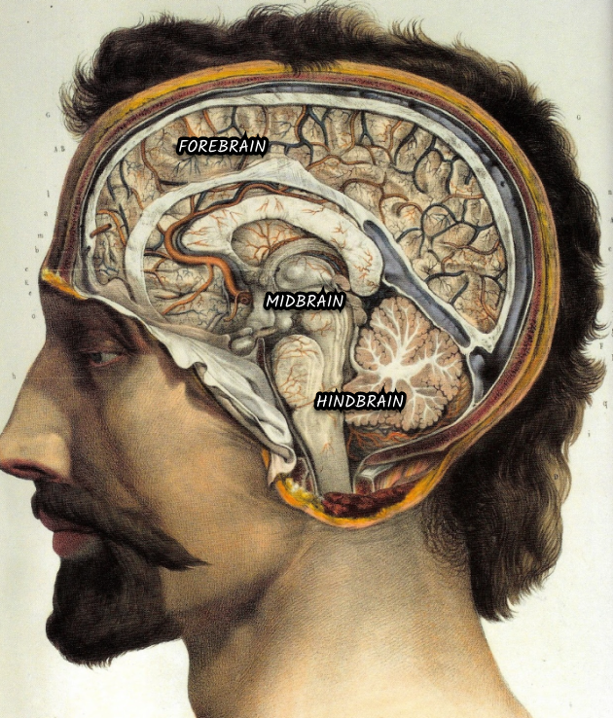
The structure of human brain
It is made up of billions of nerve cells and controls all section of body
We divide it into three parts :
Forebrain
Midbrain
Hindbrain

Slide 3
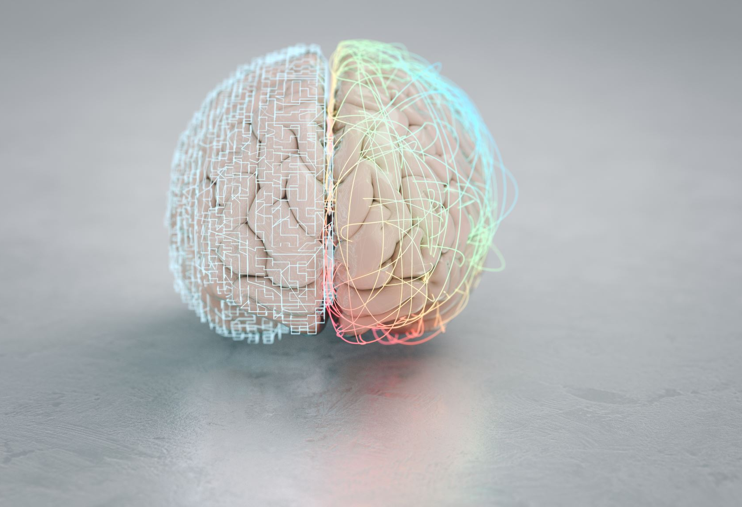
Forebrain
It is the largest part of the brain.
It is further divided into three major parts.
Cerebrum
Thalamus
Hypothalamus

Slide 4
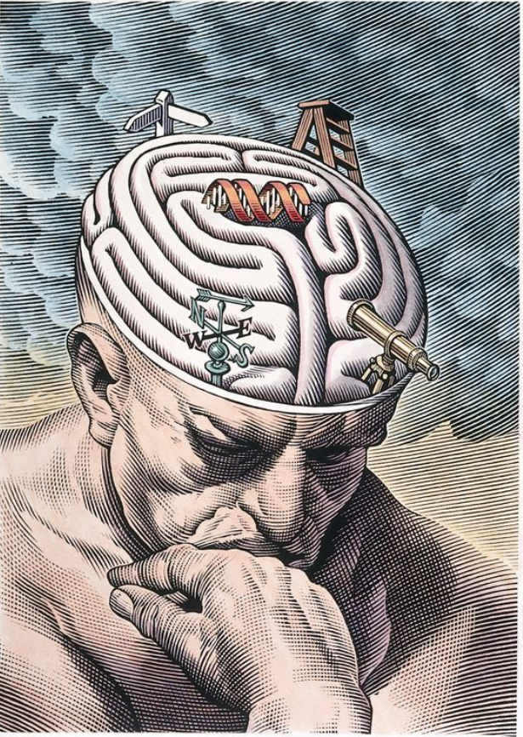
Functions of Forebrain
Forebrain is responsible for most of the brain functions
Thinking
Planning
Reasoning
Language Processing and interpreting
Processing input from our senses such as vision, touch, hearing, taste and smell.

Slide 5
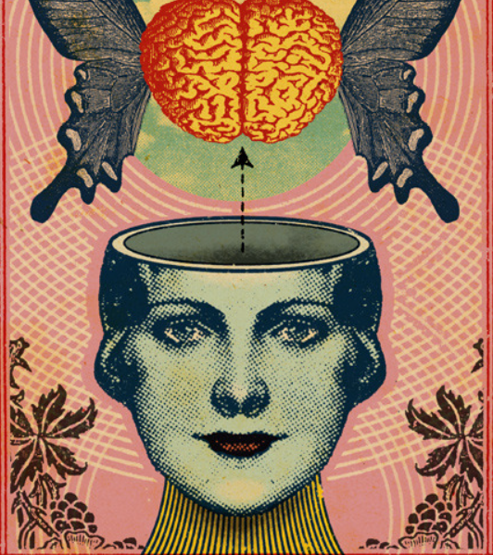
MIDBRAIN
Made up of smallest brainstem components
Some of the functions of midbrain include
Centre for visual and auditory reflexes.
Regulates eye movements.
Regulating muscles movement.
Regulating pain, mood, breathing, alertness, etc.

Slide 6
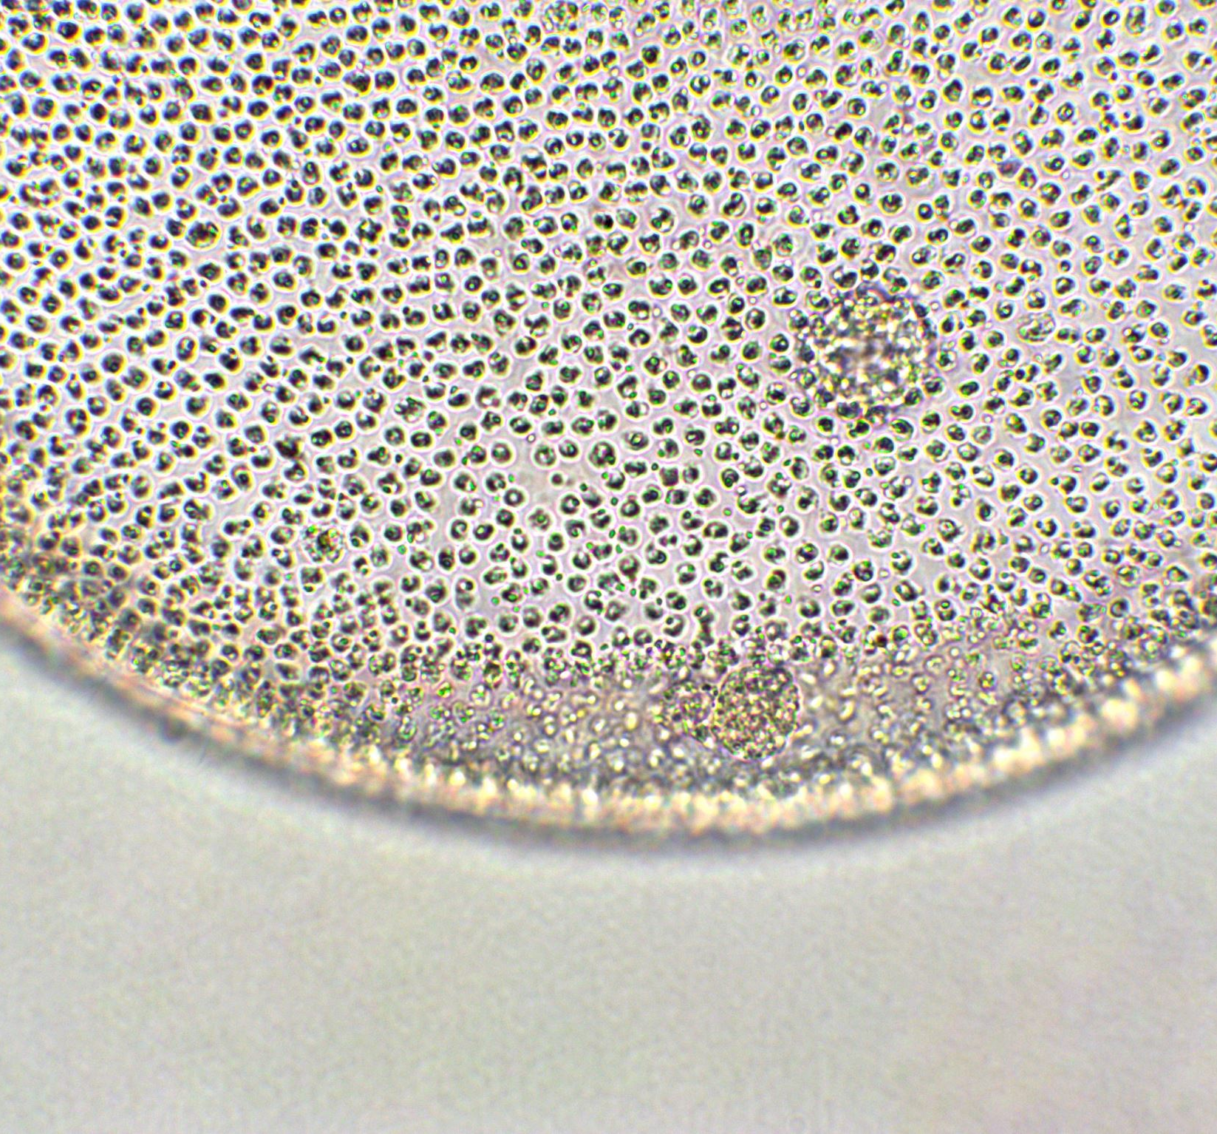
HINDBRAIN
It is located at lower back part and divided into three major parts.
Pons
Cerebellum
Medulla oblongata

Slide 7
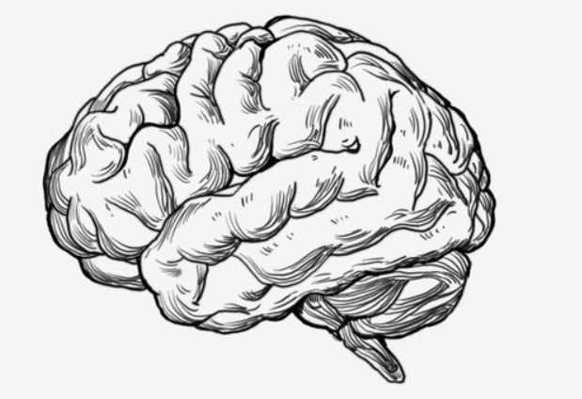
Functions of hindbrain
Regulates many vital processes and connects into the spinal cord. It is responsible for following pheromones in us
Respiration
Cardiovascular reflexes
Motor activities
Sleep-Wake cycle

Slide 8
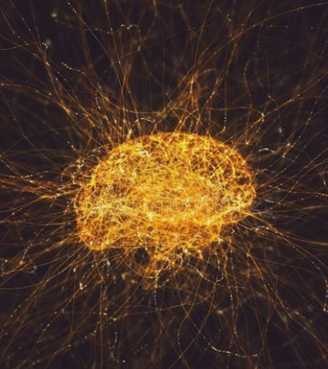
HUMAN BRAIN AND AI
Although AI is not a perfect duplicate of the human brain, it is inspired by its structure and operation.
Neurons and feedback loops are used for the human brain to process information, learn, and adapt through its various parts.
Artificial neural networks and feedback loops are used by AI systems to emulate some features of human cognition and behavior and to enhance their performance over time.

Slide 9
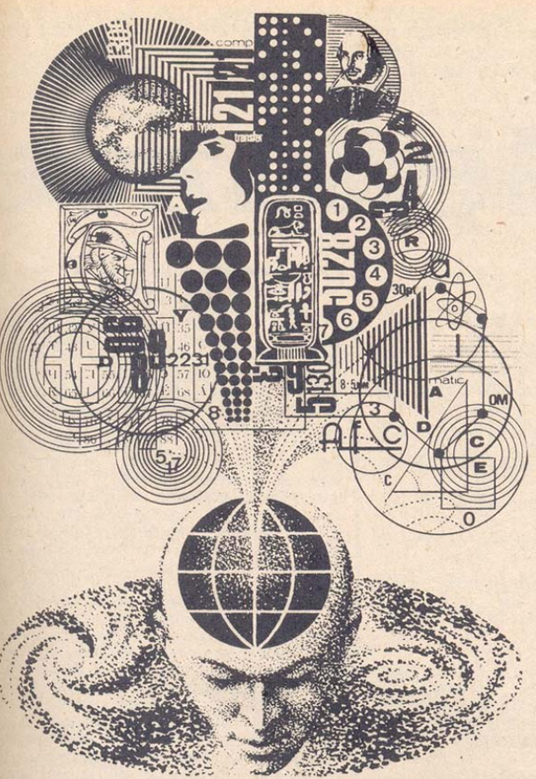
Conclusion
Hence even though AI is not a duplicate of human brain, it is inspired by human brain’s ability for mysterious and glorious feats
Human brain remains mystery to modern science and if we continue to research and analyze further aspects of human brain, we can maybe implement it to AI

Slide 10
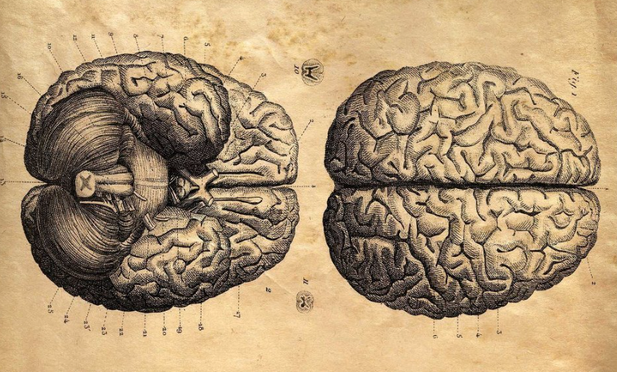
THANK YOU

